Slide 1
School system in the Czech Republic

Slide 2
Forms of education in the Czech Republic
Kindergarten
Primary education
Higher education
Profesional schools
Higher vocational education
College, Universities

Slide 3
Kindergarten
School education of children begins in kindergarten.
Children attend kindergarten from three to six years.

Slide 4
The last year in the kindergarten is obligatory for all children, it is focused on preparation for school.

Slide 5
Primary education
When children reach the age of six, they attend primary school.
The school year begins on September 1 and ends on August 31 of the following year.
It is divided into two semesters and a holiday.

Slide 6
Elementary schools have 2 levels
1st - 5th grade
6th - 9th grade

Slide 7
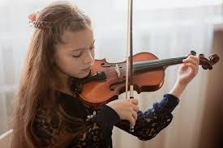
Primary schools also include
Basic Art Schools (education
in a certain fields - music,
drama, etc.) and
Basic Special Schools (for pupils who need a slower progression).

Slide 8
Education after primary school
Higher education
provides a complete general secondary education, graduation, graduation certificate.
Vocational education, provides a complete vocational secondary education - economic, artistic, medical, social, industrial schools, graduation.

Slide 9
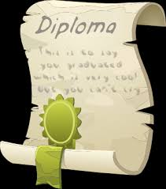
High schools and vocational schools
last 4 years.
They end with a school-leaving
examination, the student receives a school-leaving certificate.
It can be studied full-time or distance learning can be used.

Slide 10
Professional schools
3 years , final exam, receive apprenticeship certificate
Professional schools
2 years, final exam

Slide 11
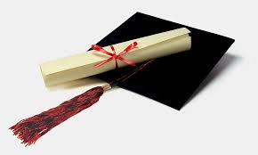
Higher vocational schools
They provide higher education.
They follow up on studies at secondary schools, they prepare for the performance of professional activities.

Slide 12
They end with graduation (theoretical exam + elaboration and defense of the graduate thesis). After 2-3 years upon completion, the title Dis (diploma specialist) is obtained along with a diploma.

Slide 13
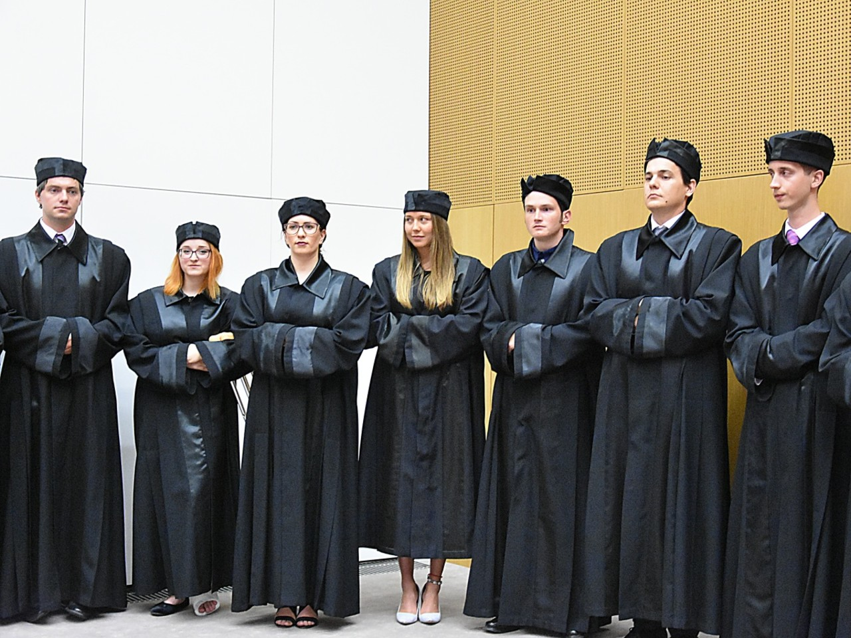
Universities
They are the highest link in the educational system.
Applicants must have
a school-leaving
examination.

Slide 14
Bachelor study program
3 years
After graduation, the graduate is entitled to the degree of Bachelor Bc., BcA - Bachelor of Arts

Slide 15
The master's study program follows on from the bachelor‘s 2 years.
The study ends with a state final examination,
which includes the defense of a diploma thesis.

Slide 16
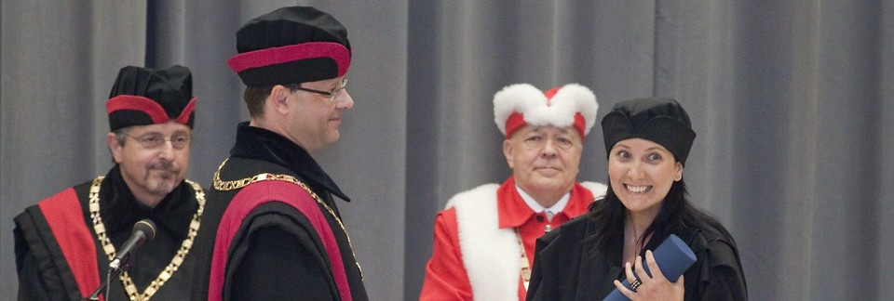
The doctoral study program follows on from the master's degree program, study period - 3 to 4 years. The study ends with a state doctoral examination, which includes the defense of a dissertation, title PhD.

